Slide 1

RNNs, LSTMs, and GRUs
Prepared by:
Ali Yassine
Yorgo Kozhaya
Marc Dagher
Presented to:
Dani Azzam
Date:
July 29, 2025

Slide 2
Outline
RNN
LSTM
GRU
Theoretical Comparison
Dataset

Slide 3
RNN

Slide 4
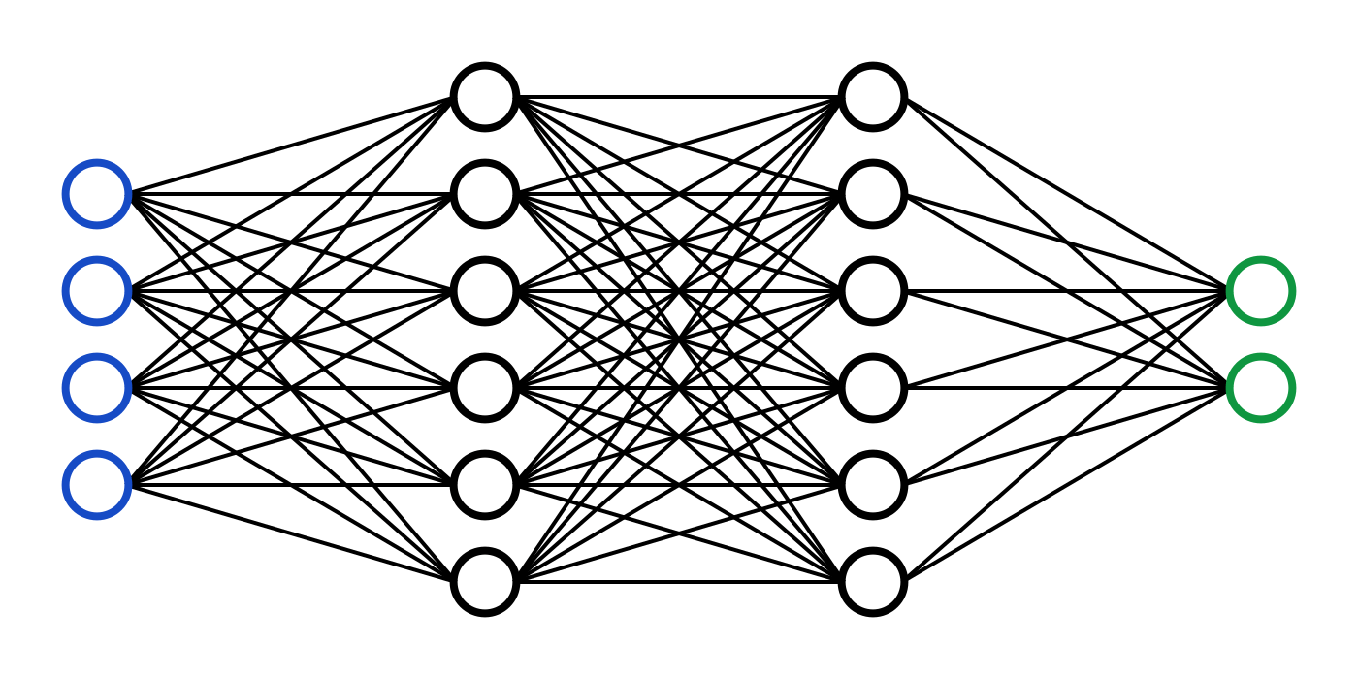
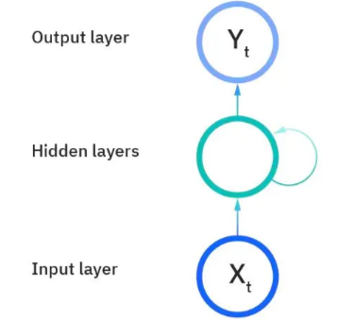
Why RNN
Neural Networks:
Inputs were processed in a single direction.
All inputs are independent from each other.
Don’t have memory of previous inputs
Not suitable for sequential data
RNN:
Made to recognize sequential data
Output depends on both current input and past context

Slide 5
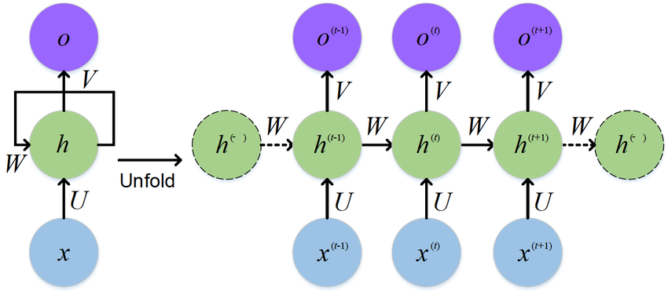
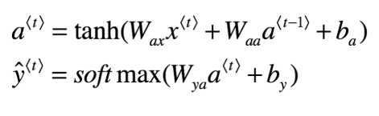
RNN Architecture
Each word is fed into the RNN one at a time.
At every step, a hidden state is calculated.
The hidden state is sent to the next word to help the model remember what came before.
The final hidden state can be used for prediction.
RNN Computations:

Slide 6
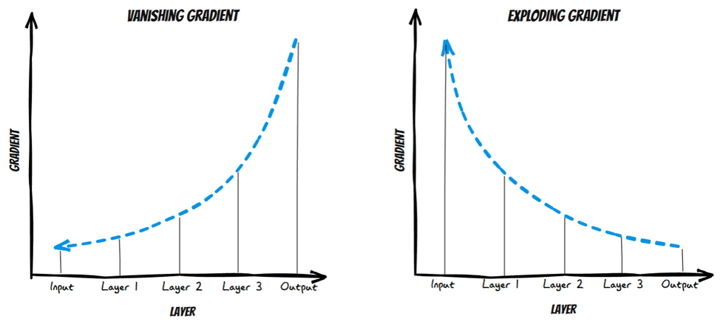
Vanishing/Exploding Gradients
Vanishing Gradient:
Gradients might become very small as they backpropagate through time.
Weights update very little, and model stops learning.
Thus, the gradient becomes almost zero.
Exploding Gradient:
Gradients become too large.
Model weights grow rapidly and may result in NaN values.
The model becomes untrainable.

Slide 7
LSTM

Slide 8
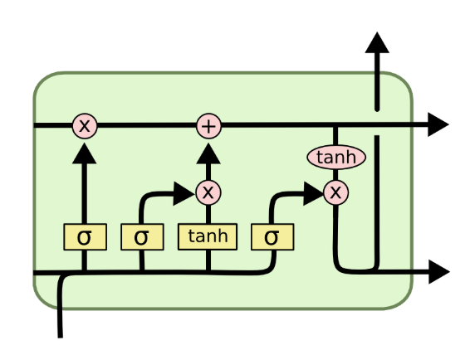
Why LSTM
Reducing information loss over long sequences
Often outperforming RNNs and GRUs in tasks like language modeling, speech recognition, and time-series forecasting
Trade-off: more complex and slower than GRUs, but often more accurate especially in handling complex data

Slide 9
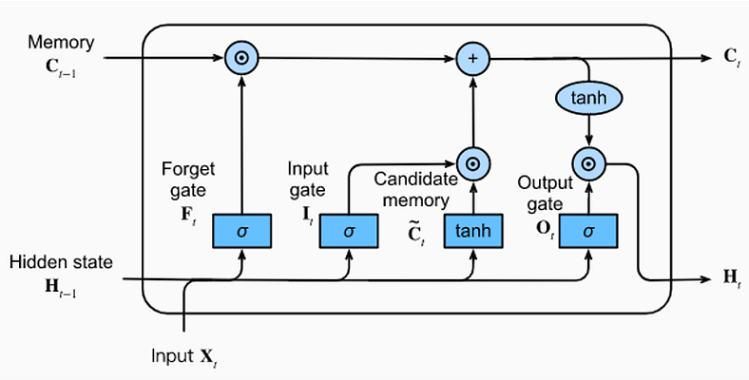
LSTM Architecture
Cell State: runs down straight down the entire chain with only some minor interactions, thus making it very easy for information to remain unchanged.
Forget Gate: decides how much information to throw away from the cell state based on the previous hidden state and current input.
Input Gate: decides what new information we are going to store in the cell state.
Output Gate: decides what parts of the cell state are going to influence the output. Thus, it takes an additional input (cell state) in comparison with the other gates.

Slide 10

Input and Output Feeding
Input Feeding: At each time step t, the LSTM receives: Current input vector xₜ Previous hidden state hₜ₋₁ Previous cell state cₜ₋₁
Output Feeding: The LSTM outputs at time t: New hidden state hₜ : used for predictions or passed to the next layer/time step Updated cell state cₜ : carried forward to preserve long-term memory
This recurrent flow continues across the sequence, allowing contextual learning over time.

Slide 11
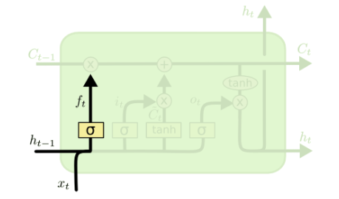
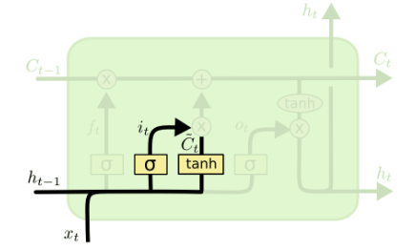
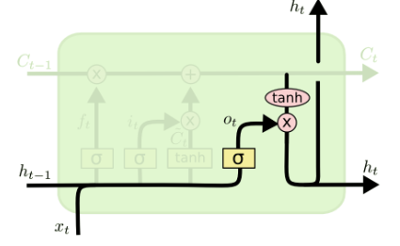




Mathematical Computations
Forget Gate
Input Gate
Output Gate

Slide 12
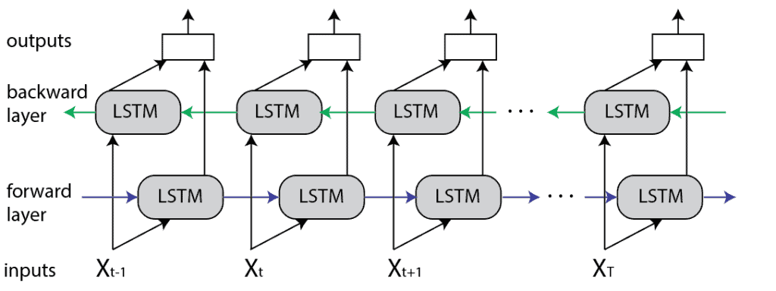
Bidirectional LSTM
Bi LSTM is an extension of LSTM where the input flows in both directions: forward and backward, thus allowing it to captures context from both past and the future
How it works: we have 2 LSTM layers
One LSTM layer processes input left to right
The other processes input right to left
Outputs are merged (via sum, avg, concatenation, …)
Advantages:
Understands full sentence context
Improves performance in several NLP tasks
Disadvantage:
Slower training and higher memory use

Slide 13
GRU

Slide 14
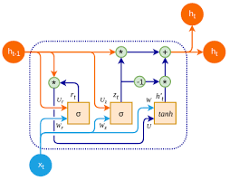
Why GRU
Just like LSTM, GRU is designed to handle sequence data and overcome issues such as the vanishing gradient problem, which affects standard RNNs during long sequence training.
GRUs can outperform LSTMs in certain tasks, especially when training speed and simplicity are important. However, for capturing long-term dependencies, LSTMs may still have the edge.

Slide 15
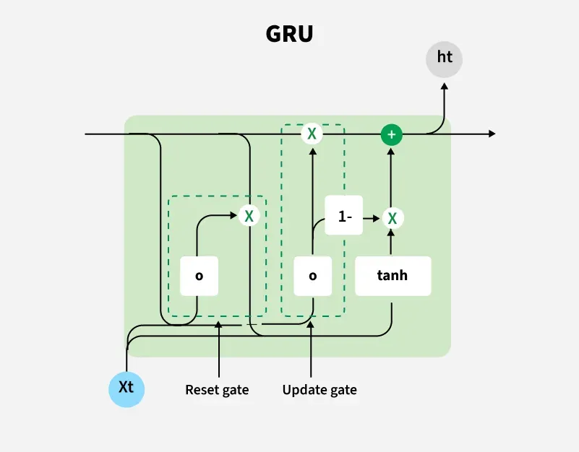
GRU Architecture
Update Gate
Controls how much of the previous hidden state to keep.
Helps decide whether to carry forward the old information or update it with new input
Reset Gate
Controls how much of the past information to forget.
Helps ignore irrelevant previous information.
Key Difference from LSTM: GRU replaces the forget and input gates with one update gate, and fuses the cell state and hidden state into a single memory unit. This makes GRUs simpler and faster while still effective at learning dependencies.

Slide 16
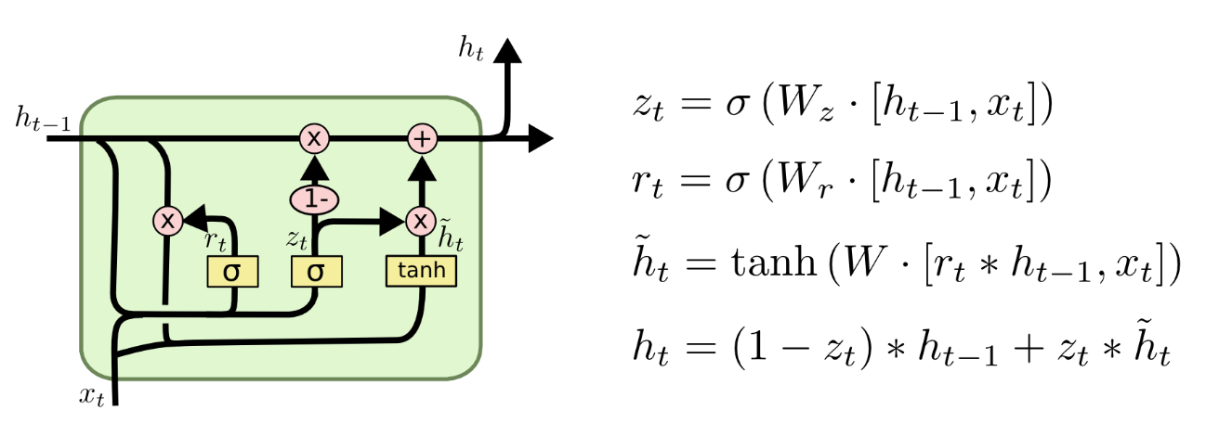
Update Gate: Computes zt which controls how much the new candidate vs past memory to keep, a value close to 1 favors the new info and a value near 0 keeps the old memory
Reset Gate: It calculates rt which controls how much of the previous hidden state to forget, if it is close to 0 the model forgets most of the past, and closer to 1 the model will keeps most of the past information
Candidate Hidden State: It’s the proposed new memory calculated from the current input and a filtered version of the past (using the reset gate) it shows what the memory would be if the model fully updated right now
Final Hidden State: It’s the actual updated memory passed to the next time step. It’s formed by blending the previous hidden state and the candidate hidden state based on how much the update gate allows updating
Concatenate input with hidden state
Update Gate
Reset Gate
Candidate Hidden State
Final Hidden State

Slide 17
Theoretical Comparison

Slide 18
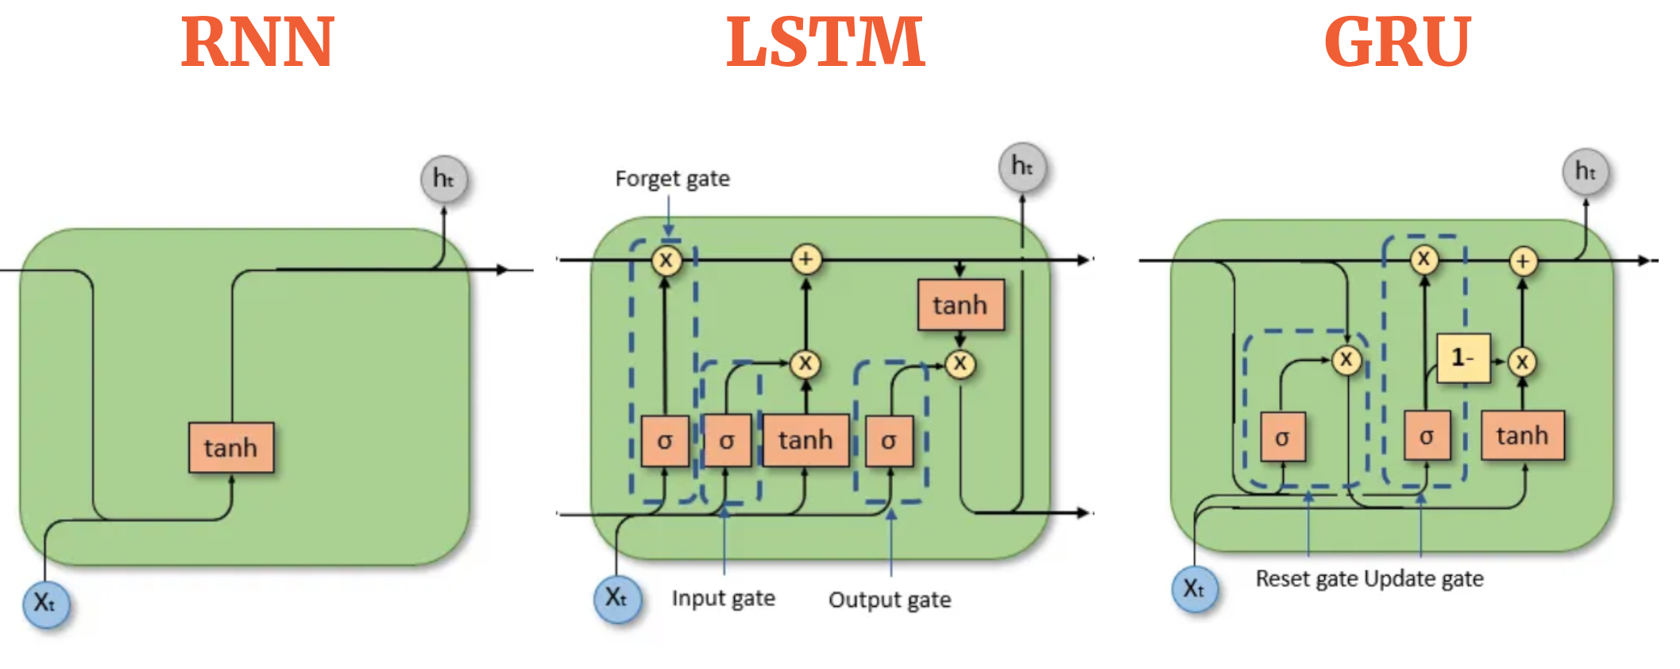
 | RNN | GRU | LSTM
Complexity | Low | Medium | High
Training Speed | Fast | Faster than LSTM | Slower
Long Sequence Handling | Poor (vanishing gradients) | Good | Excellent
Memory Capability | Weak | Moderate | Strong
Use Case Strength | Simple patterns | Efficient with moderate sequences | Deep context understanding

Slide 19
Model | Common Applications
RNN | Basic text generation Time series prediction Stock price forecasting Weather data modeling
GRU | Chatbots and virtual assistants Real-time translation (mobile/embedded) Sentiment analysis Activity recognition (wearables)
LSTM | Machine translation (e.g., Google Translate) Speech recognition (e.g., Siri, Alexa) Handwriting recognition Video classification Healthcare: ECG/EEG sequence modeling

Slide 20
Dataset

Slide 21
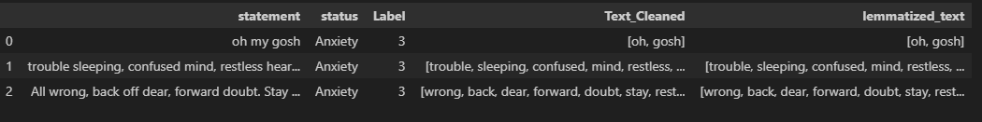
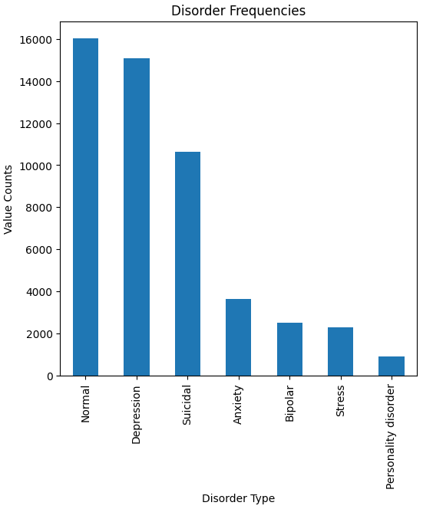
Mental Health Disorder
Duplicates removal
Labeling Disorder types
Normal= 0
Depression= 1
Suicidal= 2
Others= 3
Decontract, remove unwanted characters and stopwards
Stem/ Lemmatize words
Word2Vec Embedding

